Slide 1
Introduction to
Web Technologies
Asif Shahzad
Asif.shahzad@cuilahore.edu.pk

Slide 2
Major Objectives of Course
Architecture of Web Application
Client Side Languages -> HTML, CSS, JavaScript
Server Side Programming using Node.js
Web Services (REST API)
Database Connectivity with MongoDB
HTTP and DNS Protocol, Domain Settings
Single Page App Development using React.js
Web Application Deployment
Notes:
Make a figure of architecture…

Slide 3
Client, Server, Port, URL
Client
  A software/entity that makes request to some server. Browser make request on behalf of user, so browser is also called user-agent.
Server
  A software that serve the requests. Client and server are just processes, so they can be at same computer.
Port
  Port identify a process in computer. So a port is a number that uniquely identifies a process running in a computer.
URL
  http://example.com/search?city=lhr&type=electronics
Notes:
TCP/IP, HTTP
DNS

Slide 4
More Basic Terms
Protocol: Its format or formally defined set of rules for transmitting, representing or storage of data in same or between two entities. Aka, agreed-upon behavior. E.g. HTTP, TCP, UDP, DNS, etc.
Web Technologies: Protocols, languages, libraries and frameworks that facilitate the web applications or services development and deployment. E.g. JavaScript, HTTP, DNS, Node.js, Express, etc.
Client Side Languages: Languages that are run or interpreted at client side, usually in a web browser e.g. HTML, CSS and Java Script, etc.
Server Side Languages: Languages that run at server side and generates output for client. E.g. PHP, C#, Ruby, Java etc.
Notes:
TCP/IP, HTTP
DNS

Slide 5
Concept of Software
Tier and Layers

Slide 6
One-Tier Architecture
(Monolithic Architecture)
Tier describe deployment locations of a software components. It can be on different processes/computers.
In one-tier, all components (UI, business logic, and database) reside on a single system. Usually seen in desktop applications or simple web applications with embedded databases.
Example:
  A standalone application like MS Access File.
  An old-school PHP script with an embedded SQLite database.
Advantages:
✔ Simple to develop and deploy
✔ Faster performance for small-scale apps
Disadvantages:
✘ Not scalable
✘ Hard to maintain

Slide 7
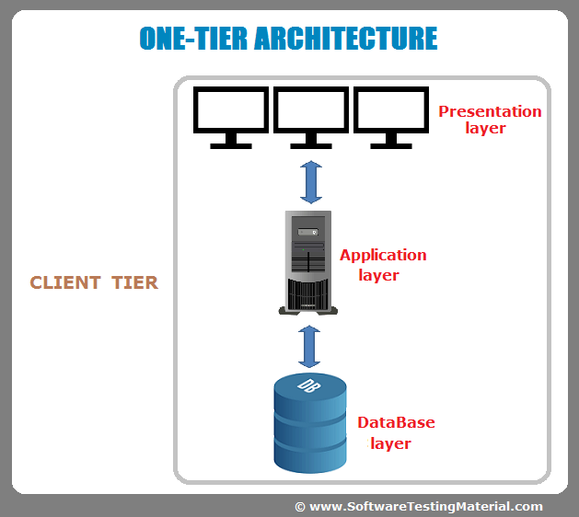
One-Tier Architecture
(Monolithic Architecture)

Slide 8
Two-Tier Architecture
(Client-Server Architecture)
The application is divided into two layers:
  Client: The front-end (browser, desktop app) sends requests.
  Server: The backend processes requests and interacts with the database.
A desktop application with separate database.
A web application with embedded database.
Advantages:
✔ Better scalability than one-tier
✔ Improved security by separating UI from the database
Disadvantages:
✘ Limited scalability (heavy load on database)
✘ Direct database exposure increases security risks

Slide 9
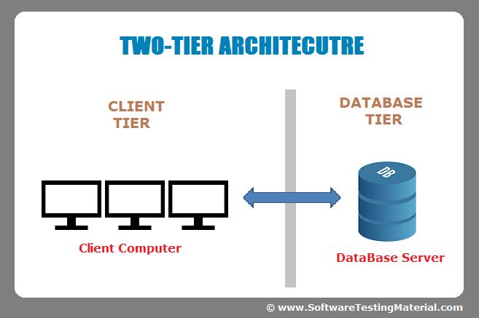
Two-Tier Architecture
(Client-Server Architecture)

Slide 10
Three-Tier Architecture
(Most Common in Modern Web Apps)
The application is divided into:
  Presentation Layer (Client): UI (HTML, CSS, JavaScript)
  Application Layer (Server): Handles business logic (Node.js, Django, Spring Boot)
  Data Layer (Database Server): Stores and retrieves data (MySQL, MongoDB, etc.)
Example: A typical web app where a React frontend communicates with a Node.js backend, which in turn queries a MySQL database.
Advantages:
✔ Highly scalable
✔ Better security (database is not exposed directly)
✔ Easier maintenance and upgrades
Disadvantages:
✘ More complex development
✘ Requires more resources

Slide 11
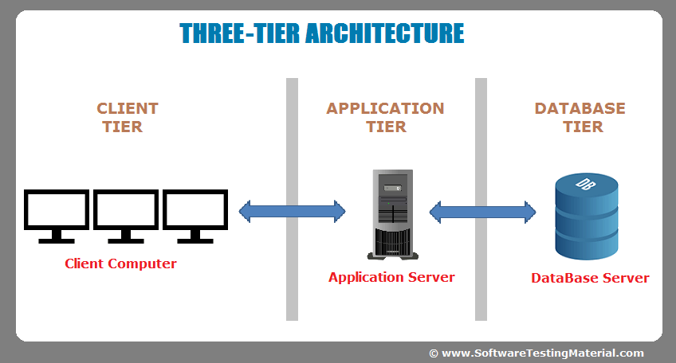
Three-Tier Architecture
(Most Common in Modern Web Apps)

Slide 12
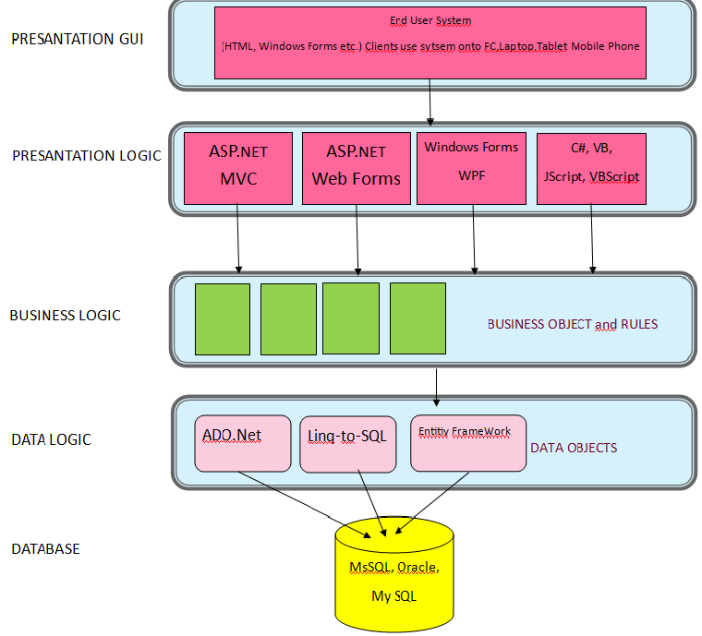
N-Tier Architecture

Slide 13
Layer
These are logical divisions in the code. They could all technically run inside one application. Usually we split code into layers for better maintainability.
Presentation Layer
↓
Business Logic Layer
↓
Data Access Layer
↓
Database

Slide 14
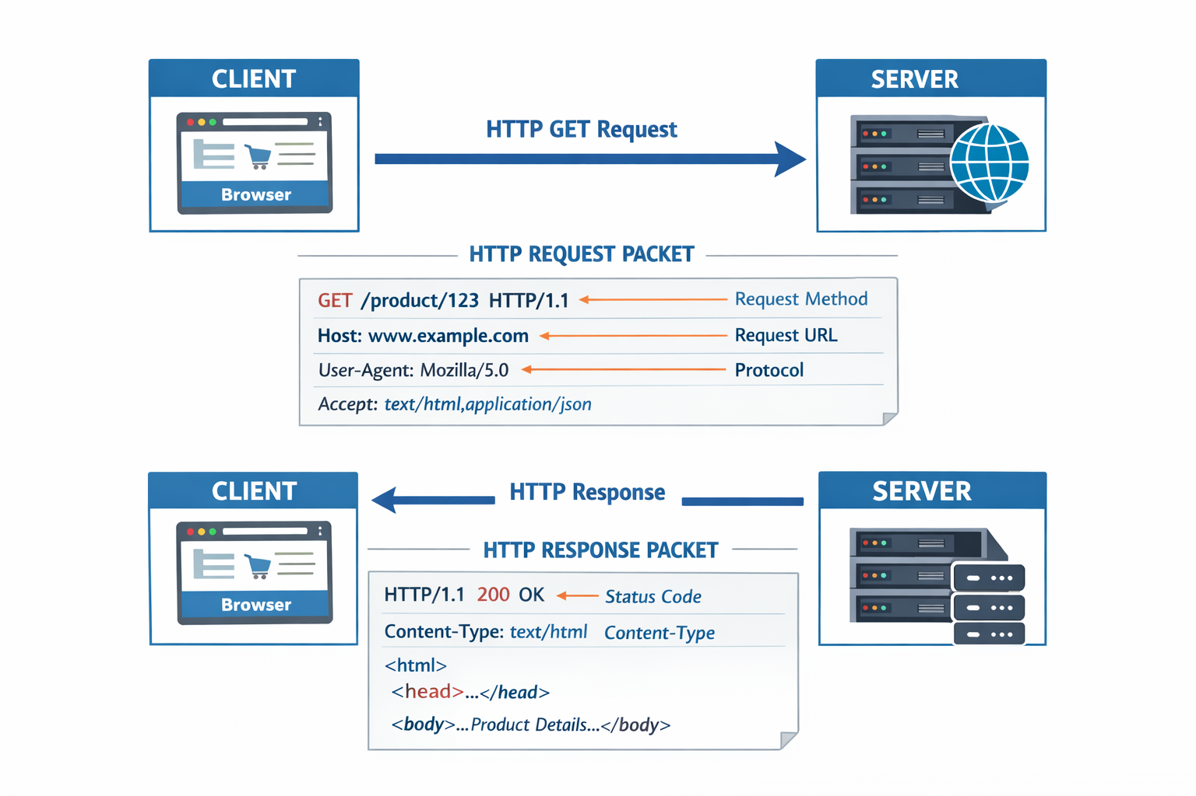
HTTP Request/Response Example

Slide 15
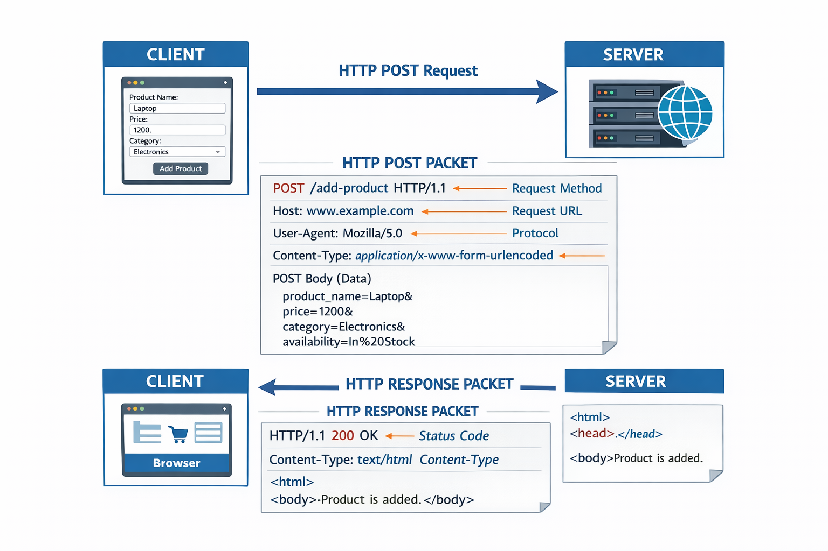
HTTP Request/Response Example

Slide 16
Service Oriented Architecture
(skip it for now , TBD later)
Expose backend of a system as different services – in language and platform independent way. E.g. RESTful Services.
Client communicate with those services.
Makes it easy to integration with other systems, no matter in which technology they are developed.
Microservices: Deploy each service as separate application, that is easy to maintain and scale.

